Slide 1
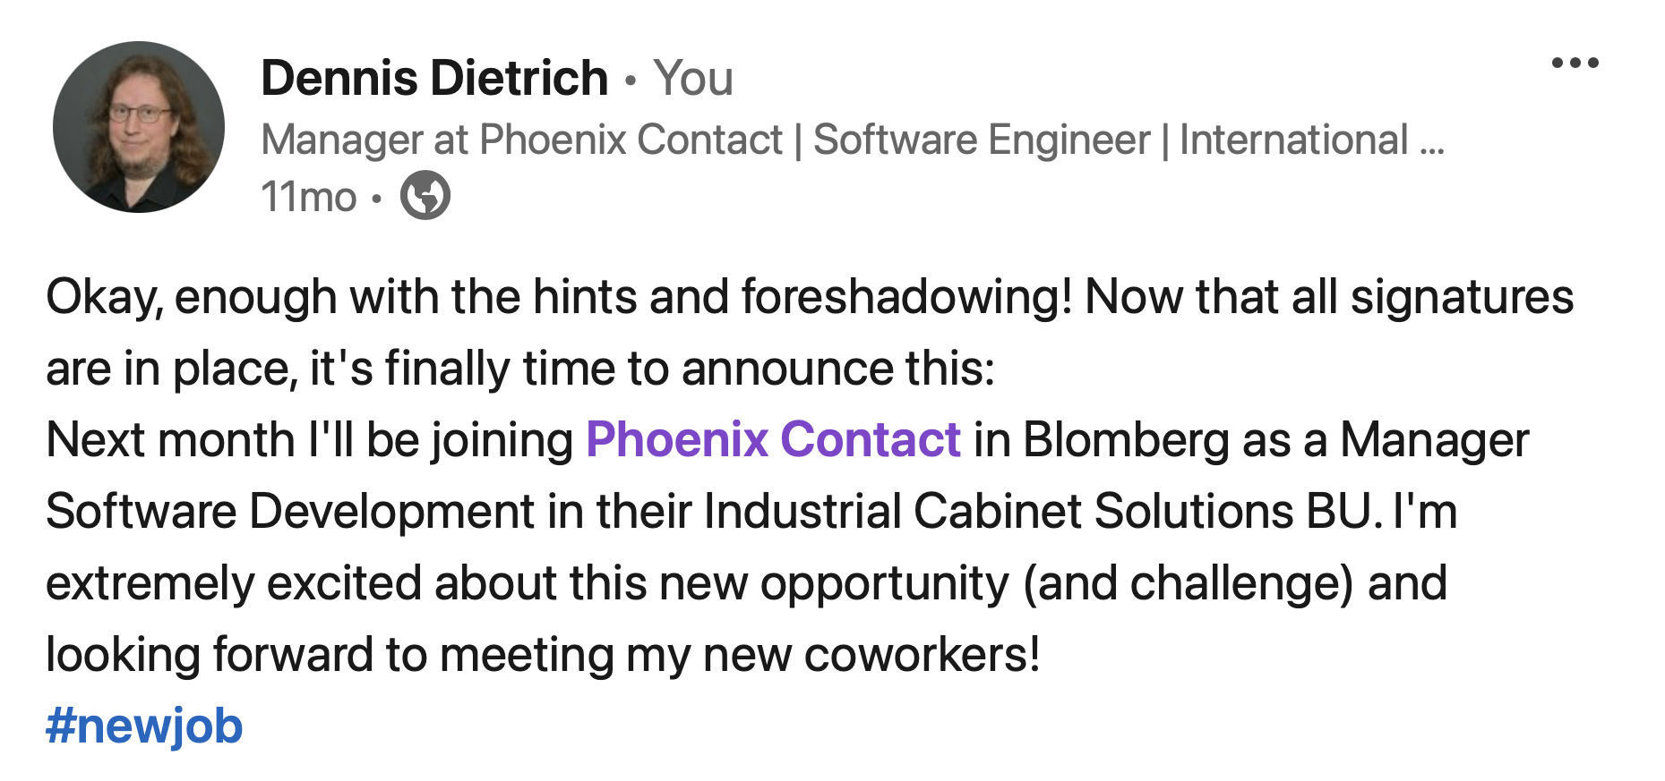
Sitting in meetings all day long
My first 180 days as a new Software Engineering Manager
Dennis Dietrich Manager Software Development ICS, Phoenix Contact
Rev. 3 (2024-08-26), https://github.com/dennisdietrich/First180Days/
Notes:
YMWV – Your Mileage Will Vary
Screenshot source: https://www.linkedin.com/posts/dcdietrich_newjob-activity-7100128322063343616-mBmN/

Slide 2

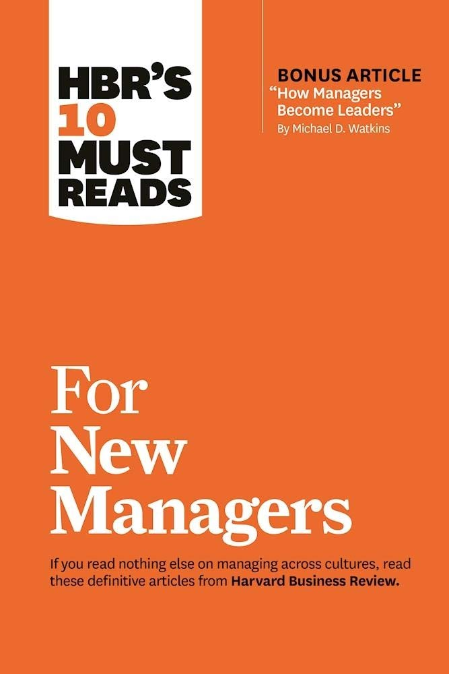



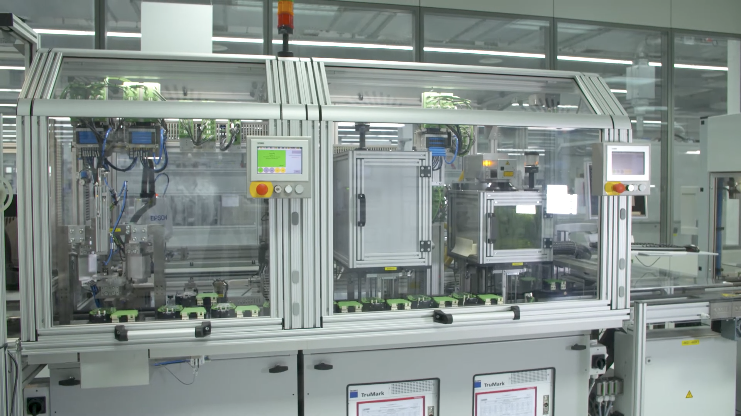
More repping: Reading… like… a lot!
Notes:
Sensors and Actuators
HBR's 10 Must Reads for New Managers (https://store.hbr.org/product/hbr-s-10-must-reads-for-new-managers-with-bonus-article-how-managers-become-leaders-by-michael-d-watkins/10134)
The Manager's Path (https://www.oreilly.com/library/view/the-managers-path/9781491973882/)
SPS-Programmierung mit IEC 61131-3 (https://link.springer.com/book/10.1007/978-3-642-00269-4)
PLC Controls with Structured Text (https://www.amazon.de/dp/8743015549)

Slide 3
Prepping: Leadership and management
Management "is the process of managing the resources of businesses, governments, and other organizations" https://en.wikipedia.org/wiki/Management
Leadership "encompasses the ability of an individual, group, or organization to 'lead', influence, or guide other individuals, teams, or entire organizations" https://en.wikipedia.org/wiki/Leadership

Slide 4
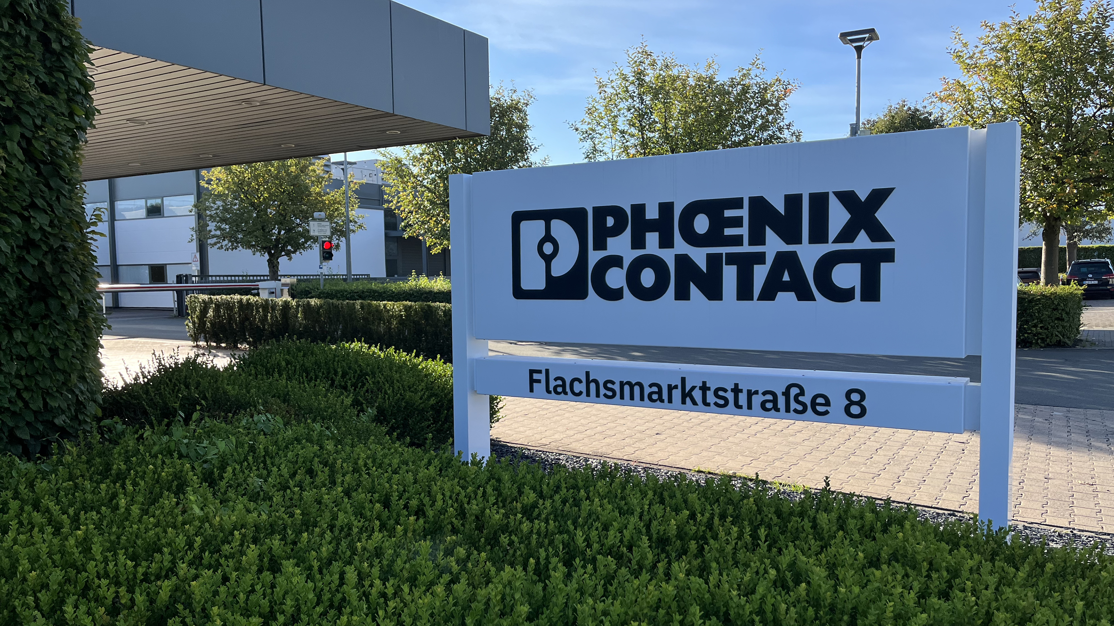
Stepping into the room…
Notes:
Photo taken on Monday 2023-09-04
- Taking charge of the team
- Owning the room
- Getting used to being the boss
- Asking if someone on the team wanted the job
- Will be different if promoted from within the team

Slide 5
Leadership and management The three kinds of leaders
Formal leaders
With authority
Without authority
Informal leaders

Slide 6
Leadership and management Servant leadership
"It doesn’t make sense to hire smart people and tell them what to do. We hire smart people so they can tell us what to do." - Steve Jobs
Notes:
“Servant leadership is a leadership philosophy in which the goal of the leader is to serve.”
https://en.wikipedia.org/wiki/Servant_leadership
It also means having peoples backs
Difference between juniors and seniors, annual goal setting

Slide 7
Leadership and management Career development
Happy where they are
Getting to the next level (e.g., Senior Software Engineer)
Technical Leadership (e.g., Tech Lead, Architect, or Systems Engineer)
Notes:
Fourth “missing” point (because it hasn’t happened in my first 180 days): Someone wants to move into management

Slide 8
Leadership and management Types of management styles I
Autocratic
Democratic
Laissez-faire

Slide 9
Leadership and management Types of management styles II
Laissez-faire
Career development, annual goals, regular 1-on-1s
Technical leadership (e.g., tech leads and architects)
Allow the team to fail!
Democratic
Deadlocked team
Role of moderator and advisor

Slide 10
Leadership and management Types of management styles III
Autocratic
Last resort!
Deadlocked team
Team cannot be allowed to fail
Performance or behavior issues

Slide 11
Leadership and management About fine print
Internal policies
NDAs
Contracts
Laws and regulations

Slide 12
Leadership and management Out of my comfort zone
Defining and improving processes
Introducing new roles
Performance management
Performance evaluation
Annual goals
Staffing reductions

Slide 13
A lessons in communication: They’ll listen… to something
New Manager, Enterprise Application Architect, Student Employee
Me: So, what about end-to-end testing?
Architect: Well, in customer journey testing…
Me: Okay, but what about the end-to-end test?!
Architect: As I explained, we have customer journey tests in which…
Me: That’s great, but I still don’t understand what we’re doing for end-to-end testing.
Student: (Crap! The new boss is getting rid of the testing role…)
(I might be out of a job!)
In marketing, the notion of customer journey portrays the process customers go through to establish a commercial relationship with a firm. The journey emphasizes touchpoints, which are the moments in which firms can interact with their current or potential customers.
https://en.wikipedia.org/wiki/Customer_experience#Customer_journey
Notes:
Also mention how asking the student about the Galen Framework was interpreted as an ask to evaluate it.
And also mention the story about someone from the hardware team remembering me talking about “having the team’s back”.

Slide 14
"Managing" in all sorts of directions
"Managing" up
"Managing" laterally
Peers…
…and their managers
…ICs on their teams
IC: Individual Contributor

Slide 15
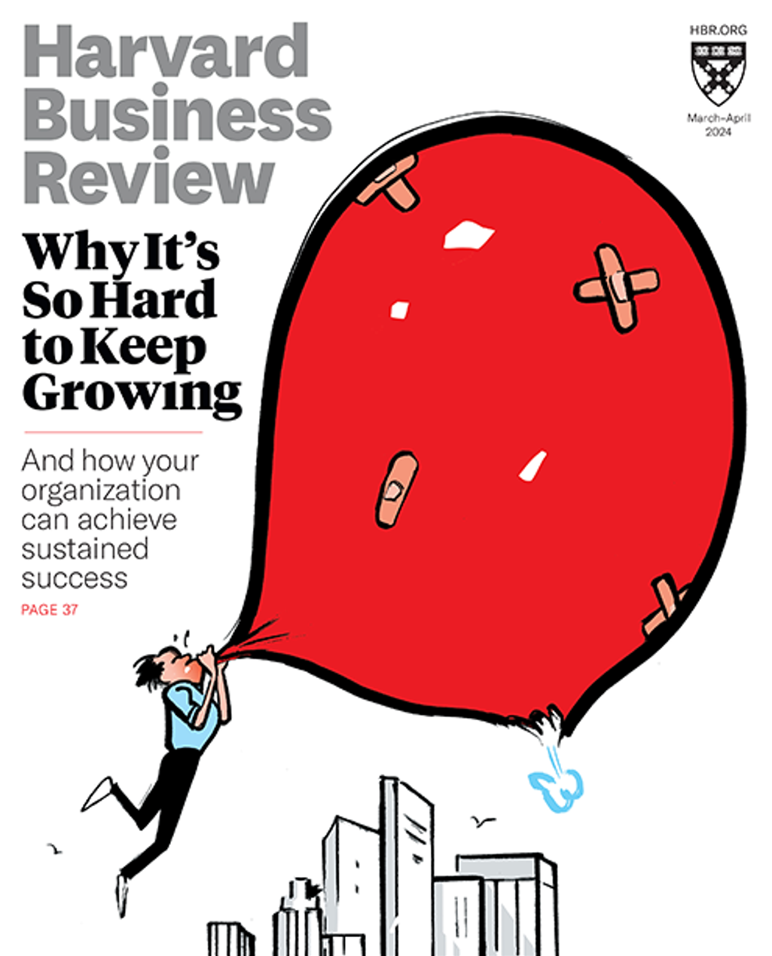


"Bi-monthly Proof I’m a Real Manager Magazine"

Slide 16
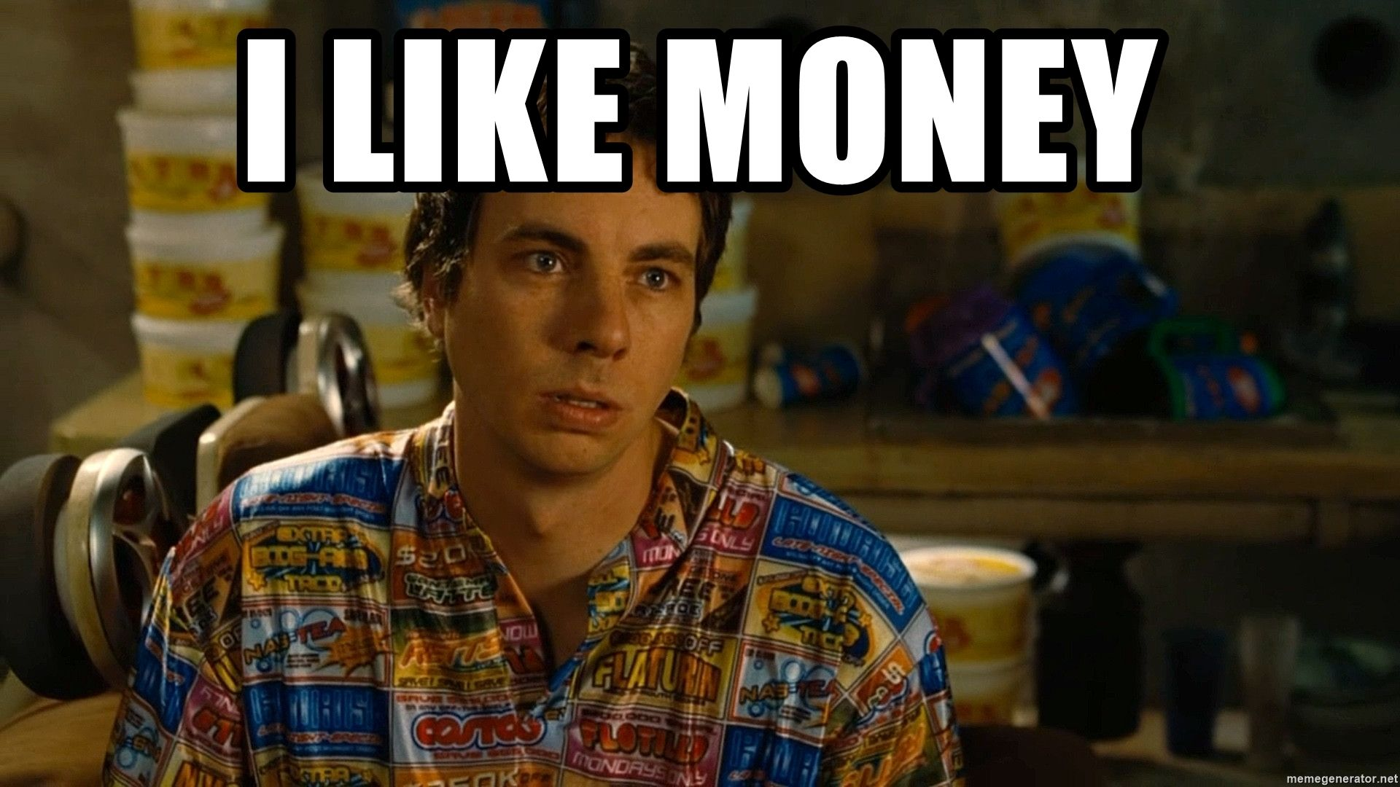
Dealing with "large" amounts

Slide 17
From retail to buying in bulk…
Functional Programming with C#, Simon Painter
I need the book: $45
My team needs the book: $450
Required reading for the company: $4,500
JetBrains All Products Pack
I need a subscription: €780 p.a.
My team needs subscriptions: €7,800 p.a.
It’s the standard for the company: €78,000 p.a.

Slide 18
…to labor costs
External developer for a quarter (at €90/h): €43,200
An additional (Junior) Software Engineer: €56,000-61,000 p.a.
An additional Senior Software Engineer: €78,000-84,000 p.a.
New team of 10 Software Engineers: > €800,000 p.a.
Notes:
External developer for a year (at €90/h): €172,800

Slide 19
What is "good" spending?
Staying within budget
Exceeding budget
Relative spend increase
R&D intensity (ratio of development cost to revenue)

Slide 20



Questions?
dennisdietrich
dcdietrich
@dc@social.advancedsoftware.engineering

Slide 21
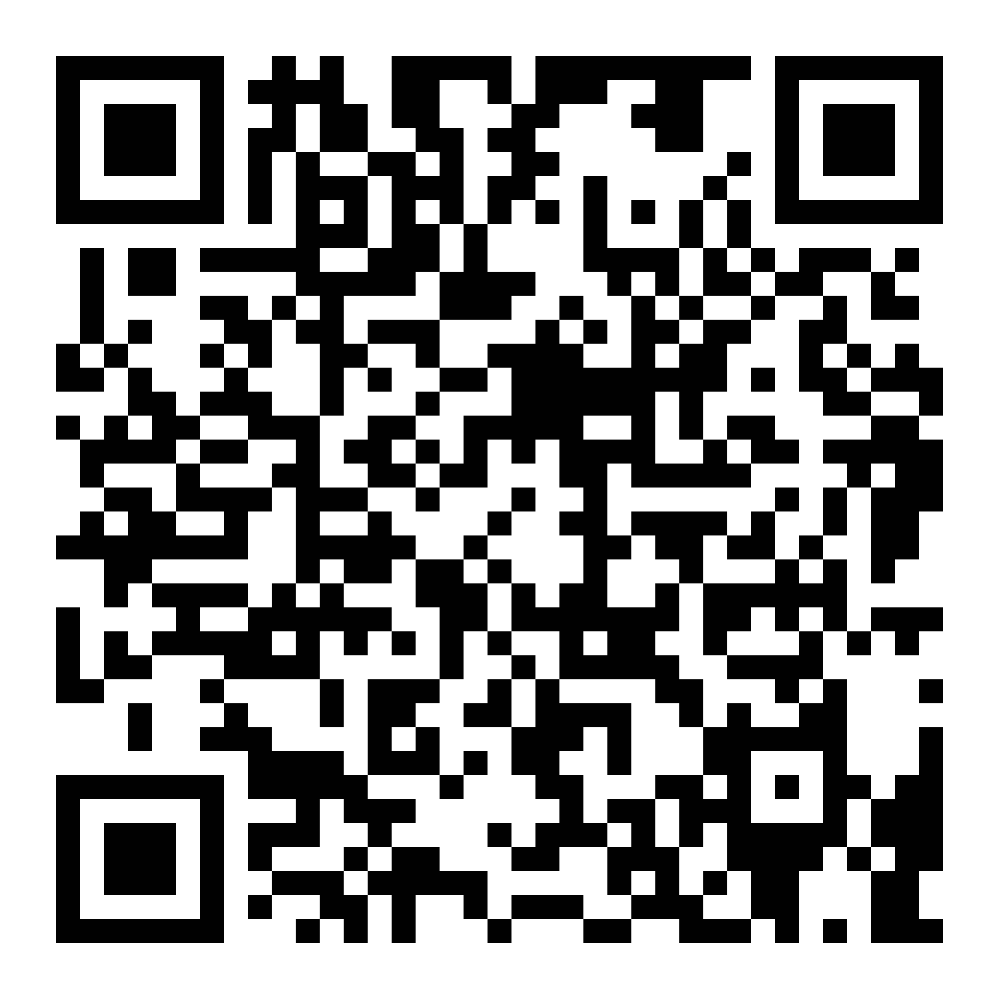
Thanks for listening!
dennisdietrich
dcdietrich
@dc@social.advancedsoftware.engineering

